Slide 1


LOGISTIC REGRESSION
Presented by
Mr. Vijay Singh Rawat
Ms. Shweta
(Research Scholar)
Ph. D
Course work 2017-18
Lakshmibai National Institute of Physical Education, Gwalior, India
(Deemed to be University)

Slide 2

INTRODUCTION
Logistic regression is a predictive analysis.
Used in a situation when a researcher is interested to predict the occurrence of any happenings.

Slide 3
Objective of Logistic Regression
The objective of Logistic regression is to find the best fitting model to describe the relationship between the dichotomous characteristics of interest and a set of independent variables.

Slide 4

Continuous vs. Categorical variables
Independent variables (x):
Continuous: age, income, height- use numerical value.
Categorical: gender, city, ethnicity – use dummies
Dependent variable (y):
continuous: consumption, time spend- use numerical value
categorical: yes/ no

Slide 5
Examples of Binary Outcomes
Should a bank give a person loan or not.
What determines admittance into a school.
Which consumers are more likely to buy a new product.

Slide 6

Uses of Logistic Regression
Prediction of group membership
It is also provides knowledge of the relationship and strength among the variables.
Casual relationship between one or more independent variables and one binary dependent variables.
Used to forecast the outcome event.
Used to predict changes in probabilities.

Slide 7

Assumptions
The relationship between the dependent and independent variable may be linear or non-linear.
The outcome variable must be coded as 0 and 1.
The independent variable do not need to be metric.
Independent variable linearly related to the log odds.
It requires quit large sample size.

Slide 8
Key terms in Logistic Regression
Dependent variable
It is binary in nature.
Independent variable
Select the different variables that you expect to influence the dependent variable.
Hosmer-lemeshow test
It is commonly used measure of goodness of fit.
Odd ratio
It is the ratio of the probability of success to the probability of failure.

Slide 9
Classification table
In this table the observed values for the dependent outcome and the predicted values are cross classified.
Maximum likelihood
Maximum likelihood is the method of finding the least possible deviation between the observed and predicted values using the concept of calculus specifically derivatives.
Logit
The logit is function which is equal to the log odds of a variable. If p is a probability that Y=1(occurrence of an event), then p/(1-p) is corresponding odds. The logit of probability p is given by

Slide 10
Predicting the Probability p
bo is the intercept and b1,b2,b3 are the slopes against independent variables x1 , xn

Slide 11
Predicting p with Log(Odds)
By knowing z the probability can be estimated

Slide 12
Advantage of using Logit Function
1
0.5
p
-
0
+
z
Figure 1- Shape of the logistic function

Slide 13
Application in Sports Research
Predicting successful free throw shot in basketball on the basis of independent variables such as player’s height, accuracy, arm strength and eye hand coordination etc.
Predicting winning in football match on the basis of independent variables like number of passes, number of turnovers, penalty yardage, fouls committed etc.,
Finding likelihood of a particular horse finishing first in a specific race.

Slide 14
Logistic Regression with SPSS
- An Illustration
Objective: Predicting success in basketball match
____________________________________________
Match Result Number of Offensive Free throws Blocks
Pass rebound throws
1 1 0 1 1 1
2 0 1 0 0 0
3 1 0 1 1 0
4 1 1 0 0 1
5 0 1 1 1 0
6 0 0 0 0 1
7 1 1 0 1 0
8 0 0 1 0 1
9 1 1 0 1 1
10 0 1 1 0 0
11 1 0 0 1 0
12 0 1 0 0 1
13 1 1 1 1 0
14 0 0 0 0 1
15 1 1 1 1 0
16 0 0 0 1 1
17 0 1 1 0 0
18 1 0 0 1 1
19 0 1 1 0 0
20 1 0 0 1 0
21 0 1 1 0 1
22 1 0 0 1 1
__________________________________________________________________
Dependent Variable
Result in Basketball Match: 1: Win
0:Loose
Independent Variable
No. of pass : 1 = lower 0 = higher
Offensive rebound : 1 = lower 0 = higher
Free throws : 1 = lower 0 = higher
Blocks : 1 = lower 0 = higher
Team having average number of pass less than the opponent is coded as 1 and the other as 0.
Similar coding for other variables

Slide 15
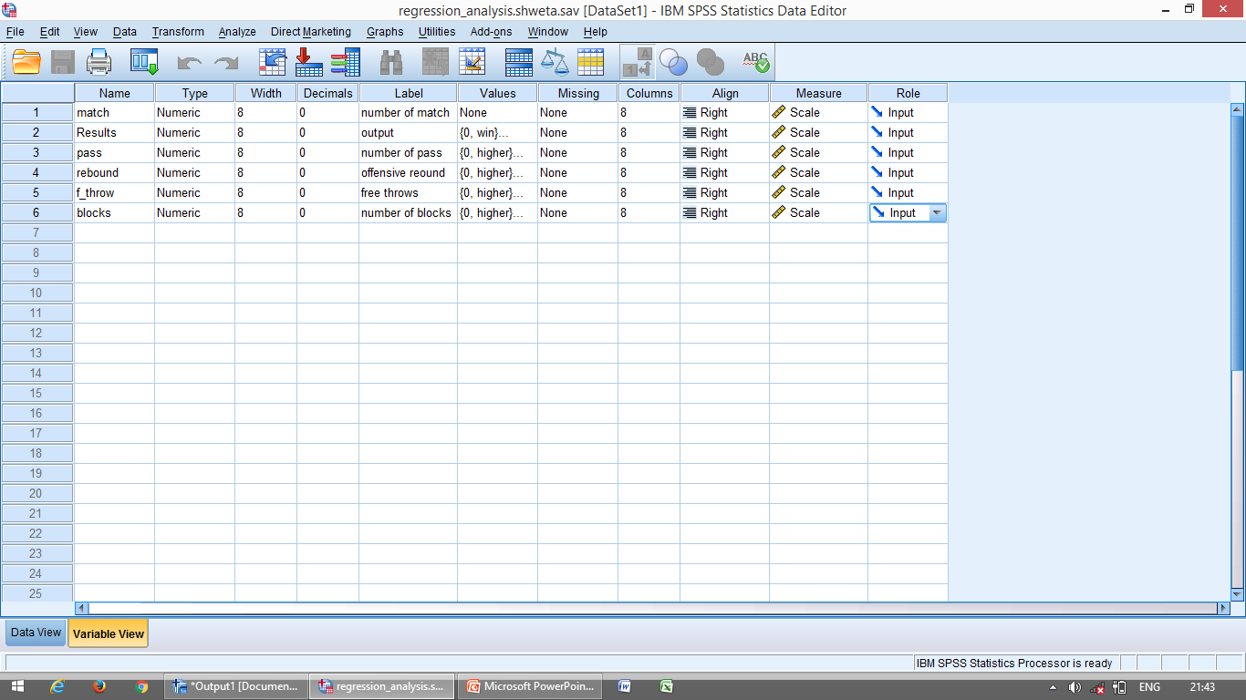
SPSS Commands for the logistic regression
Step-1 Preparation of Data file
Fig 1 – screen showing variable view for the logistic regression analysis in SPSS

Slide 16
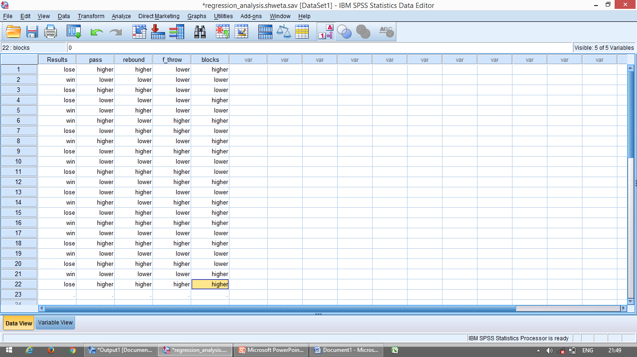
Fig 2- screen showing data file for the logistic regression analysis in SPSS

Slide 17
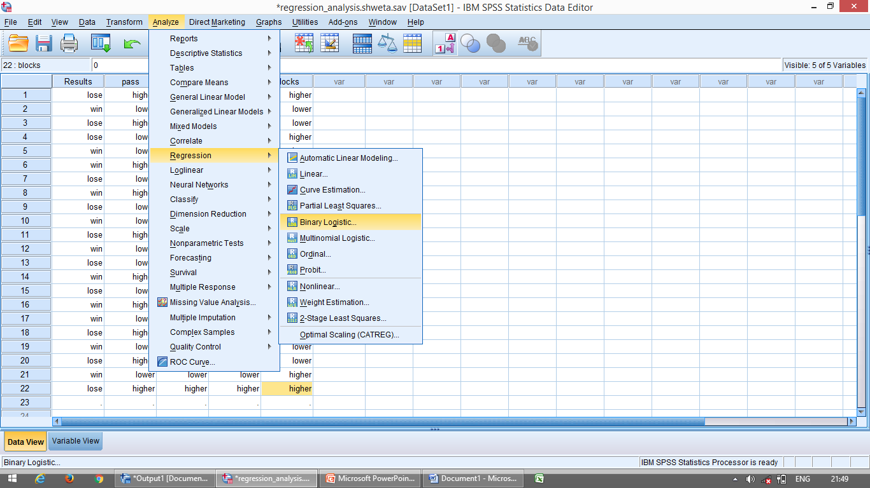
Step -2 Initiating command for logistic regression
Analyze Regression Binary logistic
Fig 3- screen showing of SPSS commands for logistic regression

Slide 18
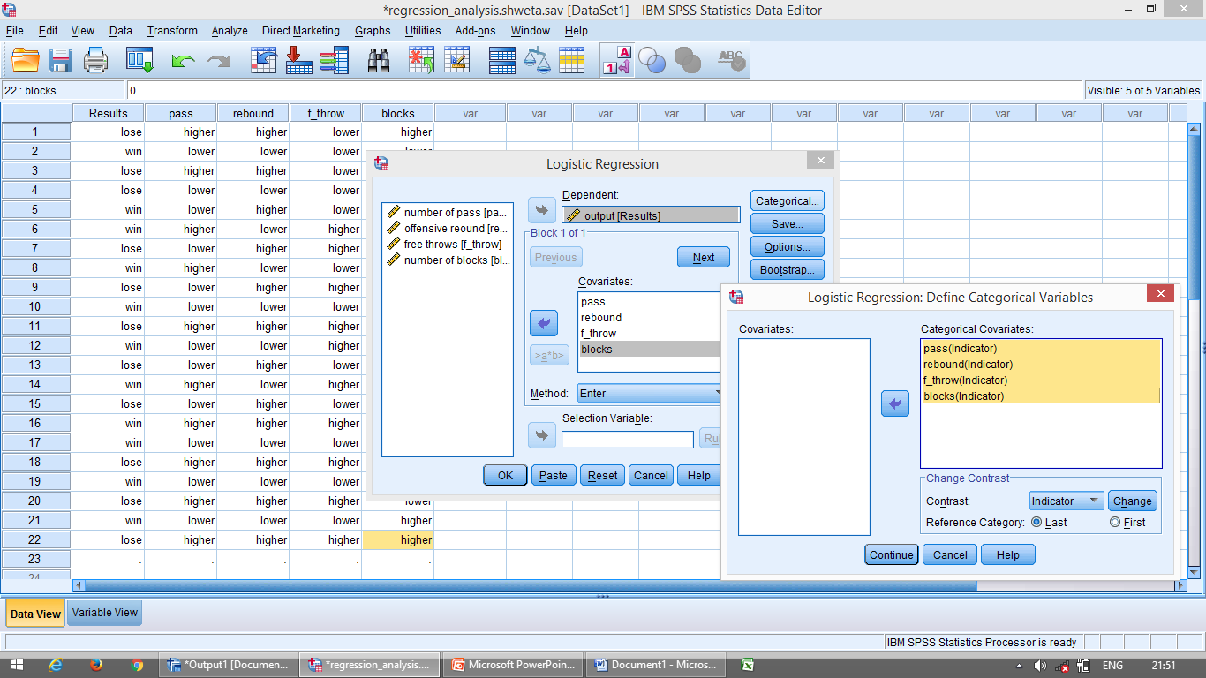
Step -3 Selecting variable for Analysis
Defining variables 1.Dependent box 2.Covariate box 3.Categorical covariate box
Fig 4- screen showing selection of variables for logistic regression

Slide 19
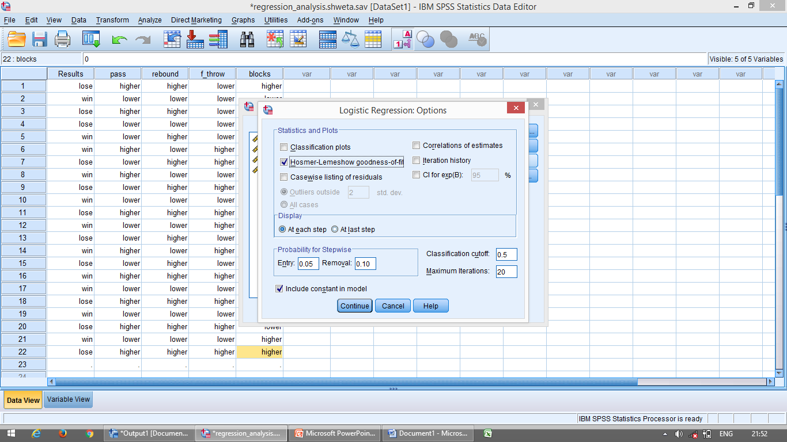
Step -4 Selecting option for Computation
CONTINUE THEN OK
Fig 5- screen showing option for generating Hosmer-lemeshow goodness of fit and confidence intervals

Slide 20
Step-5 Selecting method for entering independent variable in logistic regression
Confirmatory study
Exploratory study
Clicking the option ok to get the output
Step-6 Getting the output

Slide 21

The logistic regression in SPSS is run in two steps
First step (block 0)
It includes no predictors and just the intercept.
Second step (block 1)
It includes the variable in the analysis and coding of independent and dependent variable..

Slide 22
INTERPRETATIONS OF FINDING
Case processing summary Dependent variable encoding Categorical variable coding | Block 0 Classification table(model without predictors) Variable in the equation Variable not in the equation | Block 1 Omnibus tests of model coefficients Model summary Homer –lemeshow test Classification table (model with predictors) Variable in the equation (with predictors)

Slide 23
CASE PROCESSING AND CODING SUMMARY
TABLE 1.1 -Case Processing Summary
Unweighted Casesª |  | N | Percent
Selected Cases | Included in Analysis | 22 | 100.0
 | Missing Cases | 0 | .0
 | Total | 22 | 100.0
Unselected Cases |  | 0 | .0
Total |  | 22 | 100.0
a. If weight is in effect, see classification table for the total number of cases.
Table 1.1 shows the number of cases in each category

Slide 24
Table 1.2 shown coding of dependent variable
Table 1.2 -Dependent variable encoding
Original Value | Internal Value
Losing | 0
winning | 1

Slide 25
Table 1.3-Categorical Variables Coding
 |  | frequency | Parameter coding
 |  |  | (1)
number of blocks | lower | 12 | 1.000
 | higher | 10 | .000
offensive rebound | lower | 12 | 1.000
 | higher | 10 | .000
free throws | lower | 10 | 1.000
 | higher | 12 | .000
number of pass | lower | 10 | 1.000
 | higher | 12 | .000
Table 1.3 shown coding of categorical variable

Slide 26
B. Analyzing Logistics model
1. Block 0: logistic model without predictor
Table 1.4 -Classification Table (model without predictor)
 | Observed |  | Predicted
 |  |  | output |  | Percentage Correct
 |  |  | losing | winning
Step 0 | output | losing | 0 | 11 | .0
 |  | winning | 0 | 11 | 100.0
 | Overall Percentage |  |  |  | 50.0
a. Constant is included in the model.
b. The cut value is .500
Table 1.4 indicate that without independent variable, one simply guess that particular team win match and it would be 50% correct of the time.

Slide 27
Table 1.5-Variables in the Equation
 |  | B | S.E. | Wald | df | Sig. | Exp(B)
Step 0 | Constant | .000 | .426 | .000 | 1 | 1.000 | 1.000
Table 1.5 shows that Wald statistics is not significant as its significance value is 1.00, which is more then 0.05.
Figure 1.6-Variables not in the Equation
 |  |  | Score | df | Sig.
Step 0 | Variables | pass(1) | .733 | 1 | .392
 |  | rebound(1) | 11.733 | 1 | .001
 |  | f_throw(1) | .733 | 1 | .392
 |  | blocks(1) | .000 | 1 | 1.000
 | Overall Statistics |  | 11.942 | 4 | .018
Table 1.6 indicates whether each independent variable may improve the model or not.

Slide 28
2. Block 1 logistics model with predictors (testing significance of the model)
Table 1.7-Model Summary
Step | -2 Log likelihood | Cox & Snell R Square | Nagelkerke R Square
1 | 16.895ª | .461 | .615
a. Estimation terminated at iteration number 5 because parameter estimates changed by less than .001.
Table 1.7 shown -2 log likelihood statistics and variation in the dependent variable.
Table 1.8-Hosmer and Lemeshow Test
Step | Chi-square | df | Sig.
1 | 6.834 | 8 | .555
Table 1.8 testing goodness of fit of model with the help of chi-square value.

Slide 29
Table 1.9-Classification Tableª
 | Observed |  | Predicted
 |  |  | output |  | Percentage Correct
 |  |  | losing | winning
Step 1 | output | losing | 9 | 2 | 81.8
 |  | winning | 1 | 10 | 90.9
 | Overall Percentage |  |  |  | 86.4
a. The cut value is .500
Table 1.9 shows the observed and predicted values of the dependent variable.

Slide 30
Developing logistic model
Table 1.10-Variables in the Equation
 |  | B | S.E. | Wald | df | Sig. | Exp(B)
Step 1ª | pass(1) | -.337 | 1.452 | .054 | 1 | .817 | .714
 | rebound(1) | 4.190 | 1.556 | 7.249 | 1 | .007 | 65.990
 | f_throw(1) | -.337 | 1.452 | .054 | 1 | .817 | .714
 | blocks(1) | .834 | 1.390 | .360 | 1 | .548 | 2.303
 | Constant | -2.539 | 1.416 | 3.213 | 1 | .073 | .079
a. Variable(s) entered on step 1: pass, rebound, free throw, blocks.
Table 1.10 shows the value of regression coefficients (B), Wald statistics, its significance, and odds ratio exp(B) for each variable in both the models.

Slide 31
Developing logistic model
Log p/1-p= -2.539 + 0.834 * blocks – 0.337 * free throw + 4.190 * offensive rebound -0.337*no. of pass
Where p is the probability of winning the match.
Note-Only those variable that are found to be significant should be included in the model but for describing the results comprehensively, other variable have been included in this model.

Slide 32
Explanation of odds ratio
In table 1.11, the exp(B) represents the odds ratio for all the predictors. If the value of the odds ratio is large, its predictive value is also large.
Since odds ratio = p/1-p = p= odds ratio/1+odds ratio
For offensive rebound, p= 65.99/1+65.99=0.985
This indicate that if a team’s average offensive rebound is more then this, their probability of winning would be 0.985.

Slide 33
Interpretation of the logistic Regression model
Log p/1-p= -2.539 + 0.834 * 1 – 0.337 * 1+ 4.190 * 1 -0.337*0=2.148
Odds ratio= p/1-p=e2.148=8.5677
P= 8.5677/1+8.5677=0.8955
Thus, it may be concluded that the probability of the team A to win in the match would be 0.8955.

Slide 34

s

